Slide 1



Storage , Backup and Security - RDM
Prepared by Lucian Mshote

Slide 2
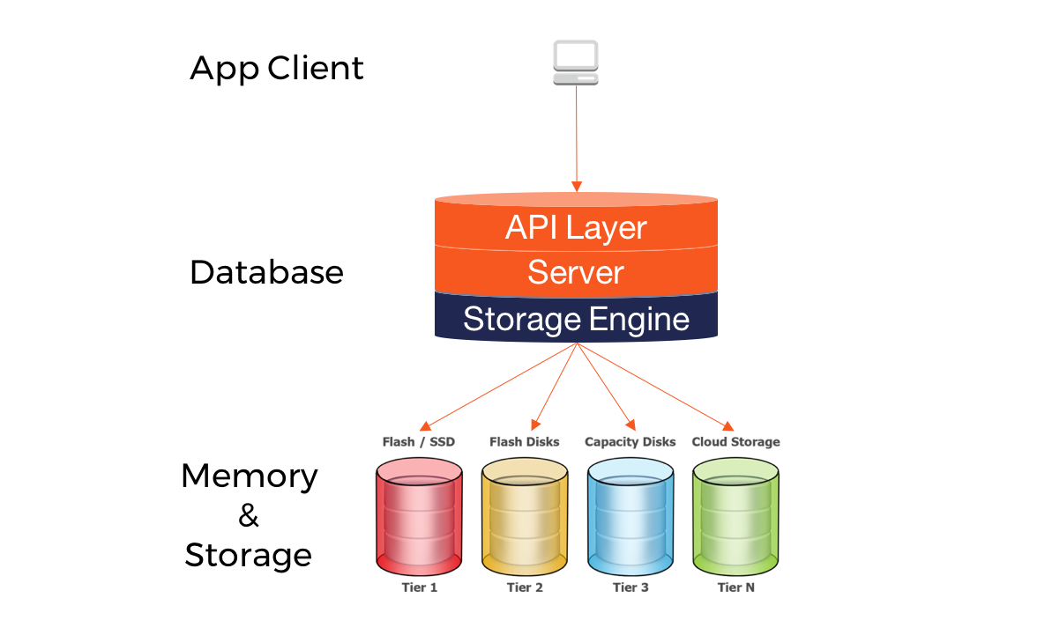
Database storage
Data storage is the collective methods and technologies that capture and retain digital information on electromagnetic, optical or silicon-based storage media.
Evaluating storage hierarchy depends on data used and the type of media it requires.
Primary storage – main app workload
Secondary storage – often used for backup and cloud storage
Storage models used DAS , NAS and SAN
A storage area network (SAN) can be designed to span multiple data centre locations that need high-performance block storage.
Relate this to SOP’s defined.
Notes:
NAS is a file-based architecture in which multiple file nodes are shared by users, typically across an Ethernet-based local area network (LAN) connection.
The advantage of NAS is that filers do not require a full-featured enterprise storage operating system. NAS devices are managed with a browser-based utility, and each node on the network is assigned a unique IP address.
In a SAN environment, block devices appear to the host as locally attached storage.
Each server on the network is able to access shared storage as though it were a direct-attached drive.

Slide 3
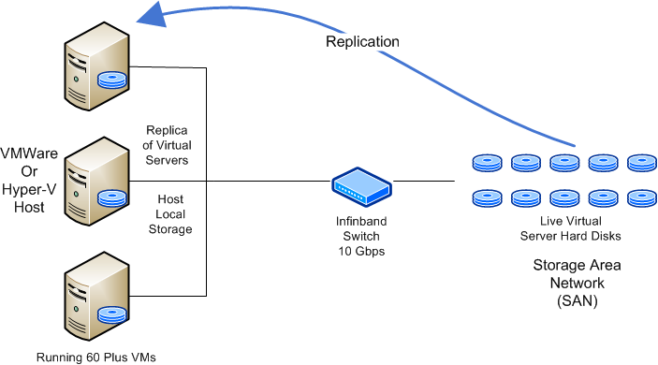
Storage area network (SAN)
This solution offers total redundancy in event of a failure.
Ease maintenance without need for downtime of hosts.
With Virtual Server Hard Disks on the SAN in the event of Host failure VMs can be moved to other hosts while issues are resolved
Notes:
Continuous connectivity is no longer a “nice to have” but is an essential requirement of modern businesses.
What is also of utmost importance is the protection of the data that is stored, not only is important to retain data for the interest of the organisation, in many circumstances it is a legal requirement.

Slide 4
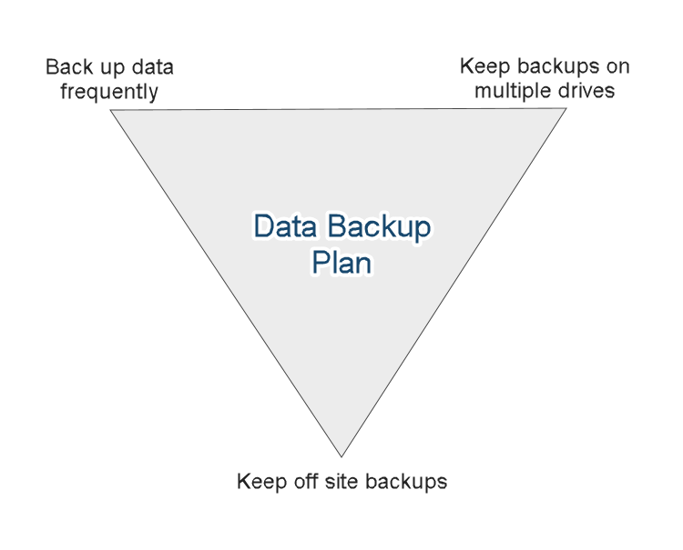
Backup plan and strategies (1/4)
Defining a backup plan is dependent to
Data size
Return to normalcy policy
Location of storage
Retention policy
Determine the acceptable Loss.
How much data can we lag behind upon recovery and how long is the downtime period i.e RPO(recovery point objective) and RTO (Reovery time objective)
Types of database backup
Full backups
Differential backups
Incremental backups.
Partial backups
Notes:
Continuous connectivity is no longer a “nice to have” but is an essential requirement of modern businesses.
What is also of utmost importance is the protection of the data that is stored, not only is important to retain data for the interest of the organisation, in many circumstances it is a legal requirement.

Slide 5
Case 1: MySQL databases – Full backup (2/4)
Back up both system and user databases.
This entail doing complete dump on the data files with inclusion of Log files.
Then over the periodic day do incremental backups thro’ flush log.
App server 1
App server 2
Data flow to and from the DB
MySQL DB
Run a backup process for mysql instance, i.e. mysqldump
Backup

Slide 6
Case 2: MySQL database replication (3/4)
In this model the primary database is replicated to the secondary database.
It highly recommended where reliability and availability is high.
This process involves setting master database server which will be the source DB and creating a slave database which will receive committed transactions from master.
During setup it important to note the delay time for logs.
Notes:
TPd affects how fast to pick on the logs from the master.

Slide 7
Database Backup plans (4/4)
Define plan for data backup
Establish a strategy for handling VLDB backups
Establish an appropriate backup schedule and window
Decide where to store backups
Develop a backup retention policy
MySQL Server Database
Backup process
Restore backup
Verify Backup
Scheduler
Purge Backup
Report
MySQL backup and restore process review

Slide 8

Effective Backup Management
Key point to note are :
Automating backups: use OS scheduling tool or third party tools for this eg workbench.
Monitoring backups: monitor backup process with alerts in event of backup failures
Validate backups: have routine validation and verification process without actual restore
Database backup catalog: this making review of backups which are outside the retention policy of the organization.

Slide 9

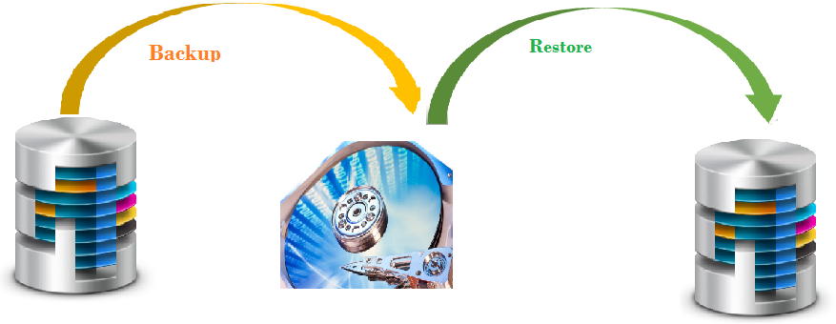
Disaster Recovery strategies (DR) - (1/3)
Term describes the activities done to restore a database in event of crush, or catastrophic events.
The plan should include
The remote site for emergency.
Different server to be used.
Off-site storage of the backups and archive logs.
The plans defined all revolve within
Recovery point objective
Recovery time objective
Notes:
In this process u can use mirror or replication for quick turnaround. however, it is generally not possible to recover all of the transactions up to the time of the disaster, i.e., some of the active log files may be lost.

Slide 10
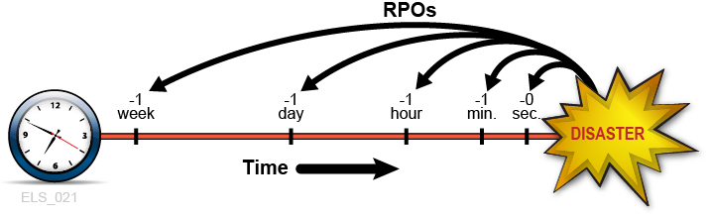
DR - Recovery Point Objective(RPO) - (2/3)
It defines the maximum tolerable period in which data might be lost from an IT service due to a major incident.
This model focuses on data loss acceptability by the programme.
It has also to be documented on the BCP plan
To reduce this risk there is need for:
Use mirroring of DB’s
Replication
Clustering
Notes:
is the amount of time that passes that’s “acceptable” to you during an emergency situation. You should define this amount of time in your business continuity plan. If you exceed this period of time, you could jeopardize your business.
Database mirroring is the creation and maintenance of redundant copies of a database. The purpose is to ensure continuous data availability and minimize or avoid downtime that might otherwise result from data corruption or loss, or from a situation when the operation of a network is partially compromised.

Slide 11
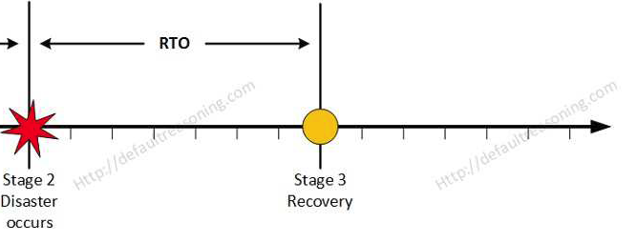
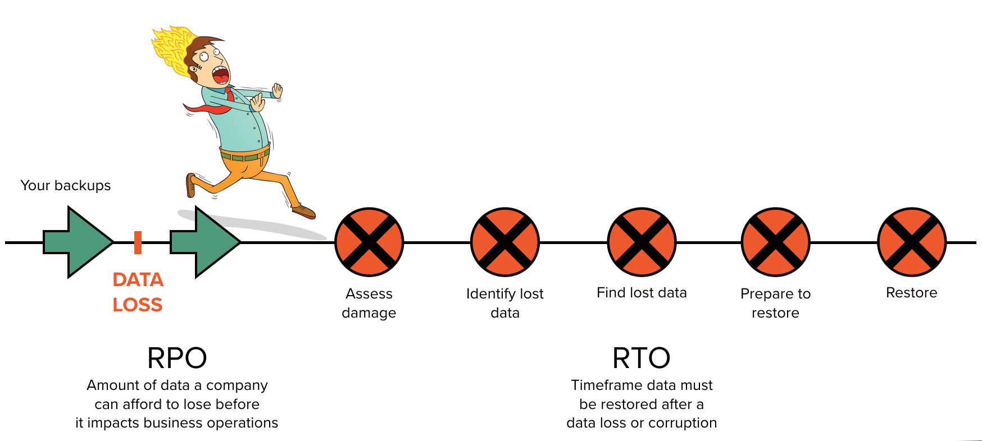
DR - Recovery Time Objective(RTO) - (3/3)
It’s the duration of time and a service level within which ab business process must be restored after a disaster so as to prevent unacceptable losses.
This process is very time specific with respect to data restored.
Will define BCP this is established in business impact analysis(BIA) by study owner.
RTO notes the process affected not the resources.
Notes:
to avoid unacceptable consequences associated with a break in business continuity.
The RTO and the results of the BIA in its entirety provide the basis for identifying and analyzing viable strategies for inclusion in the business continuity plan.
This would include alternate or
manual workaround procedures and would not necessarily require computer systems to meet the RTOs

Slide 12
Security in Data management (1/3)
This refers to collective measure to protect and secure a database or DMS from illegitimate use and malicious access or threat.
For the measures to be robust its key for below to be defined:
Data owners.
Data custodian/Steward
Data users
System Administrator
Notes:
generally managers and directors responsible for using information for running and controlling the business. Also authorizing access, ensuring that access rules are updated when personnel changes occur
2. Data Custodian or Data Steward – These people are responsible for storing and safeguarding the data, and include IS personnel such as system analysis and computer operators.
3. Data Users – Data users, including internal and external user community, are the actual user of computerized data.

Slide 13

Data Security: Role based access(2/3)
it’s the method of restricting access of to specific parts of data application and data rights.
rights to data is granted based on ones responsibilities and Job desc.
To implement this:
Determine the areas and resource that need control
Analyze the work force.
Define a policy and adapt with changing environment.
Notes:
Establish roles that have the same access needs. However, don't create too many roles because that would defeat the purpose of role-based access control and create user-based access control rather than role-based access control

Slide 14
Data Security: Role based access (3/3)
Benefits of role based
Improved operational efficiencies
Enhance compliance
Improved Visibility
Decreasing the risk of data breaches and leakage.
Notes:
sec 1. RBAC lets organizations quickly add and change roles, as well as implement them across platforms, operating systems (OSes) and applications.
Sec 2. implement RBAC systems to meet the regulatory and statutory requirements for confidentiality and privacy because executives and IT departments can more effectively manage how the data is accessed and used.
Sec3.

Slide 15
Acknowledgements

